Slide 1
Disclaimer
It is not uncommon to see the uproar that manipulated images cause in media. Some slides have images containing messages that may be controversial in nature. The sole purpose of displaying these altered images is to show the seriousness of this issue and consequently the threat these manipulated images can cause to world peace .
The messages in these images don’t reflect the views of the presenters, people involved in this project or University at Albany.

Slide 2

Hezbollah’s “Made In USA” Billboard in Southern Beirut

Slide 3
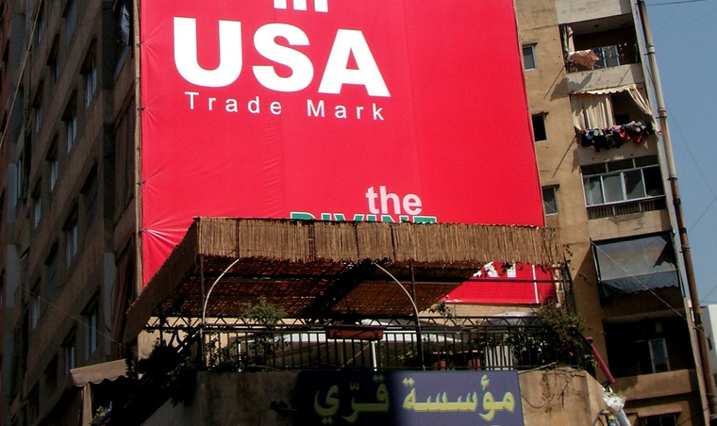

AUTHENTIC !!

Slide 4
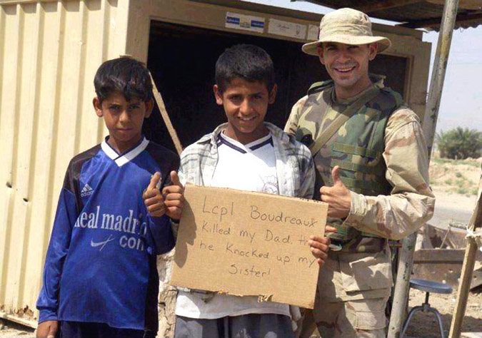
Photograph showing a U.S. Marine posing with Iraqi kids holding a provocative sign, April 2004

Slide 5
“Lcpl Boudreaux killed my Dad. Th(en) he knocked up my Sister !”

Slide 6
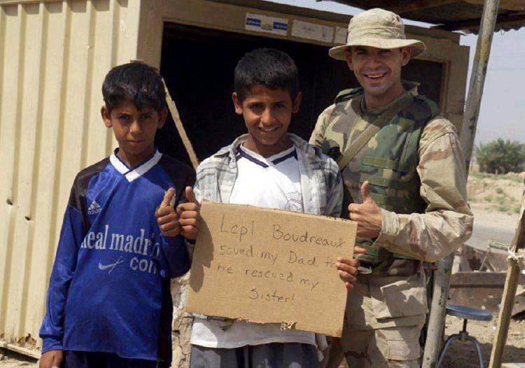
Another Version: The ‘Positive’ morph

Slide 7
“Lcpl Boudreaux saved my Dad. Th(en) he rescued my Sister !”

Slide 8
Villian ?
War
Hero ?
Peace

Slide 9
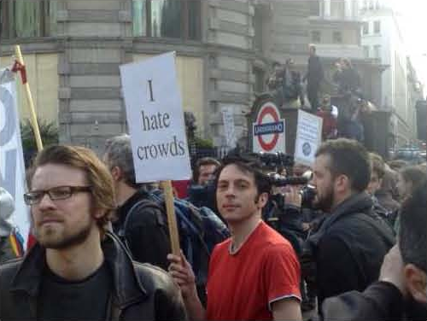
Detecting Photo Manipulations on Signs and Billboards
Matthew Frey & Darshan Shinde
Dept. of Computer Science,
University At Albany, NY.

Slide 10

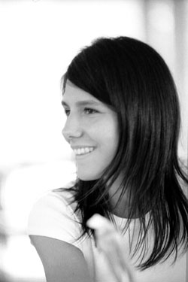
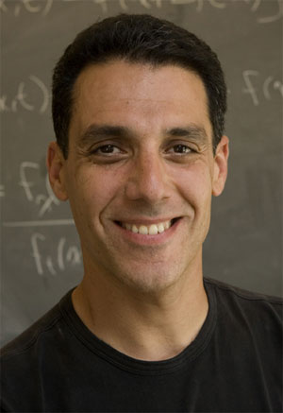
Our Application is based on Research Paper of
Valentina Conotter
Giulia Boato
Hany Farid
University of Trento, Trento (Italy)
Dartmouth College, NH

Slide 11
Basic outline of the technique used
“When text is on a planar surface and imaged under perspective projection, the text undergoes a specific distortion. When text is manipulated, it is unlikely to precisely satisfy this geometric mapping, which can be detected.”
We exclusively concentrate on Projections
in our work.

Slide 12
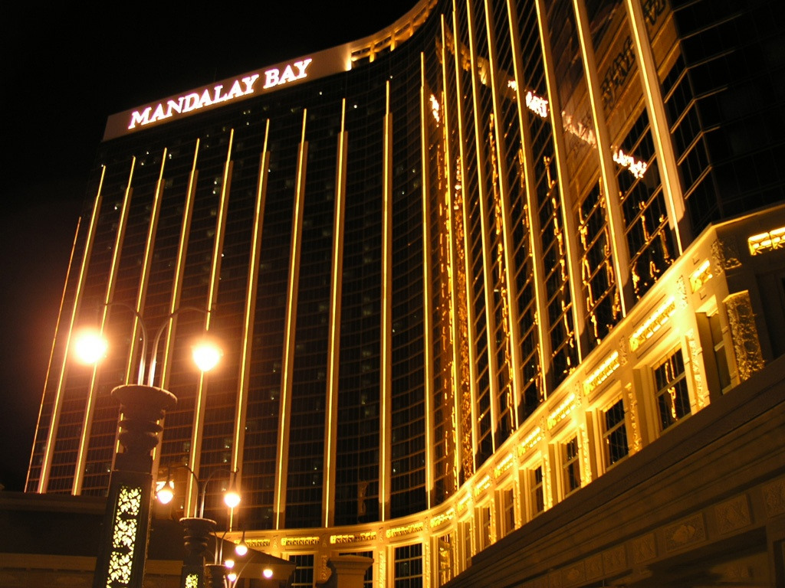
Example

Slide 13
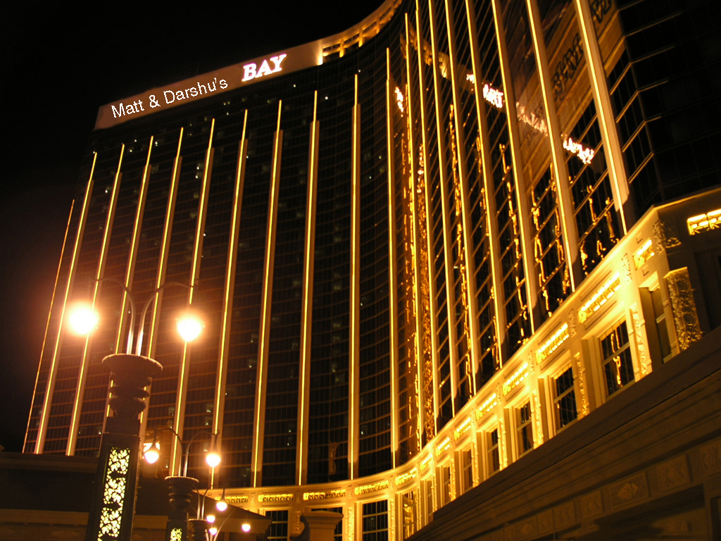
Example : Crude Edit Using MS-Paint

Slide 14
Detection Techniques mentioned in the Paper
Planar Homography
Known Font
Unknown Font
Photo Composite
}
Applied
}
Future Work

Slide 15
Planar Homography
A homography is an invertible transformation from a projective space to itself that maps straight lines to straight lines.
Synonyms are collineation, projective transformation, and projectivity.

Slide 16
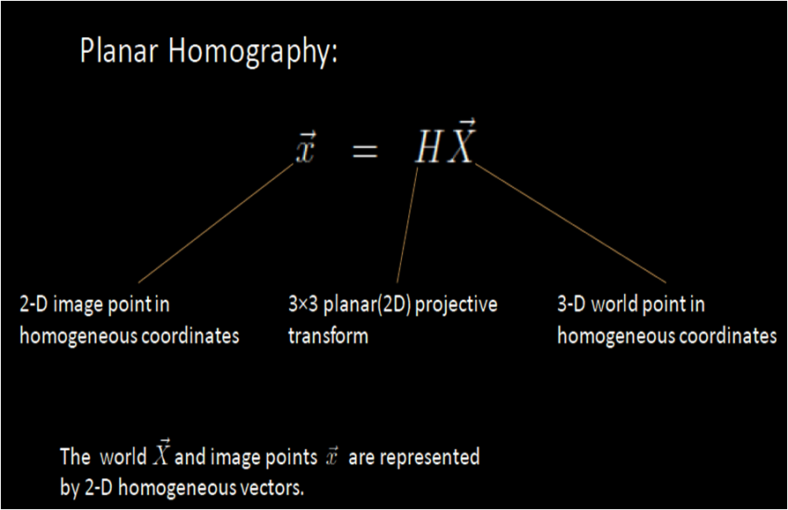

Slide 17
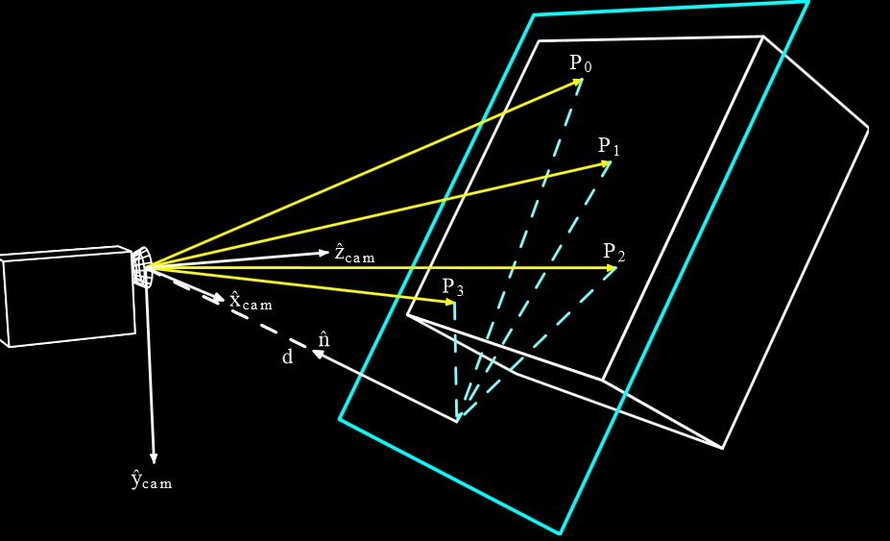
Plane of Text
Projections
drawn to
each point

Slide 18
Plane 2
Projections 2
Projections 1
Plane 1
Projections 1 and 2 are not parallel in case of inconsistencies

Slide 19

Welcome to Fabulous Las Vegas

Slide 20
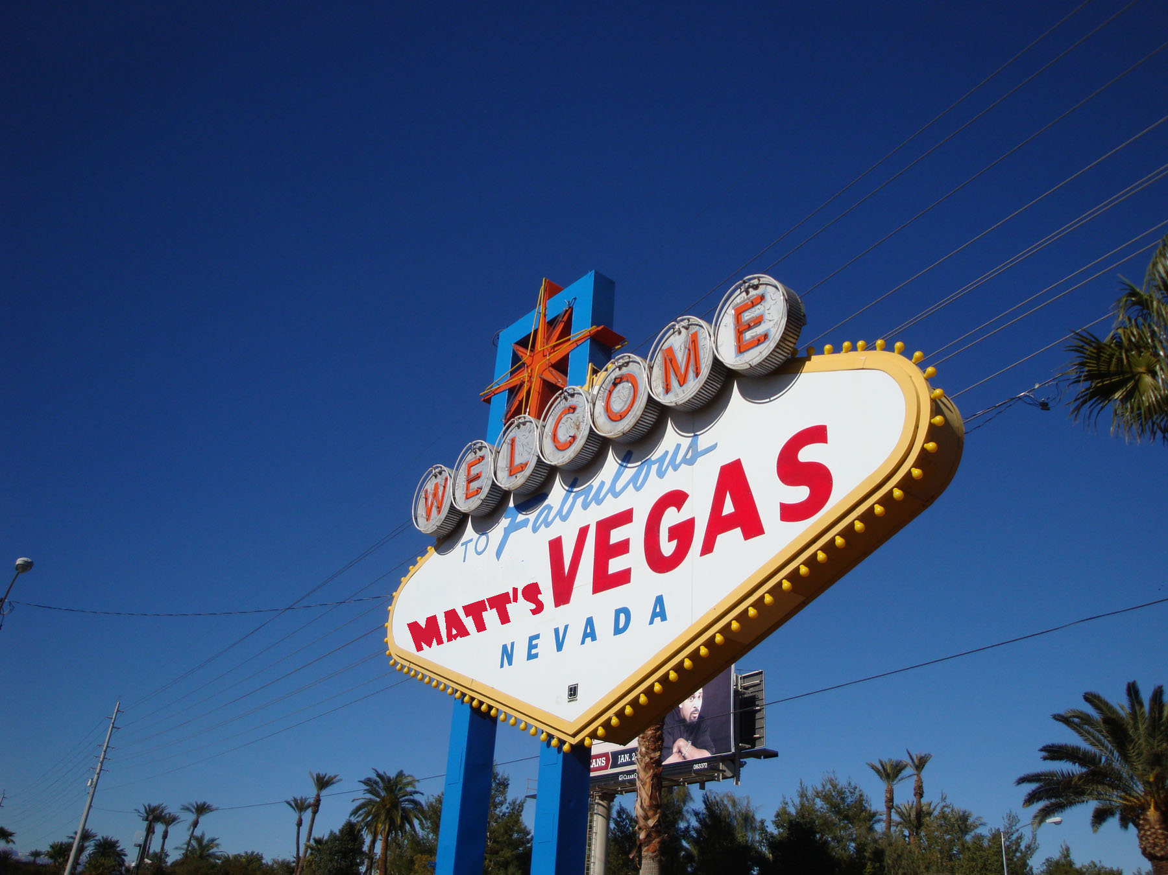
A ‘Refined’ edit using Photoshop (Scaled, Rotated)

Slide 21
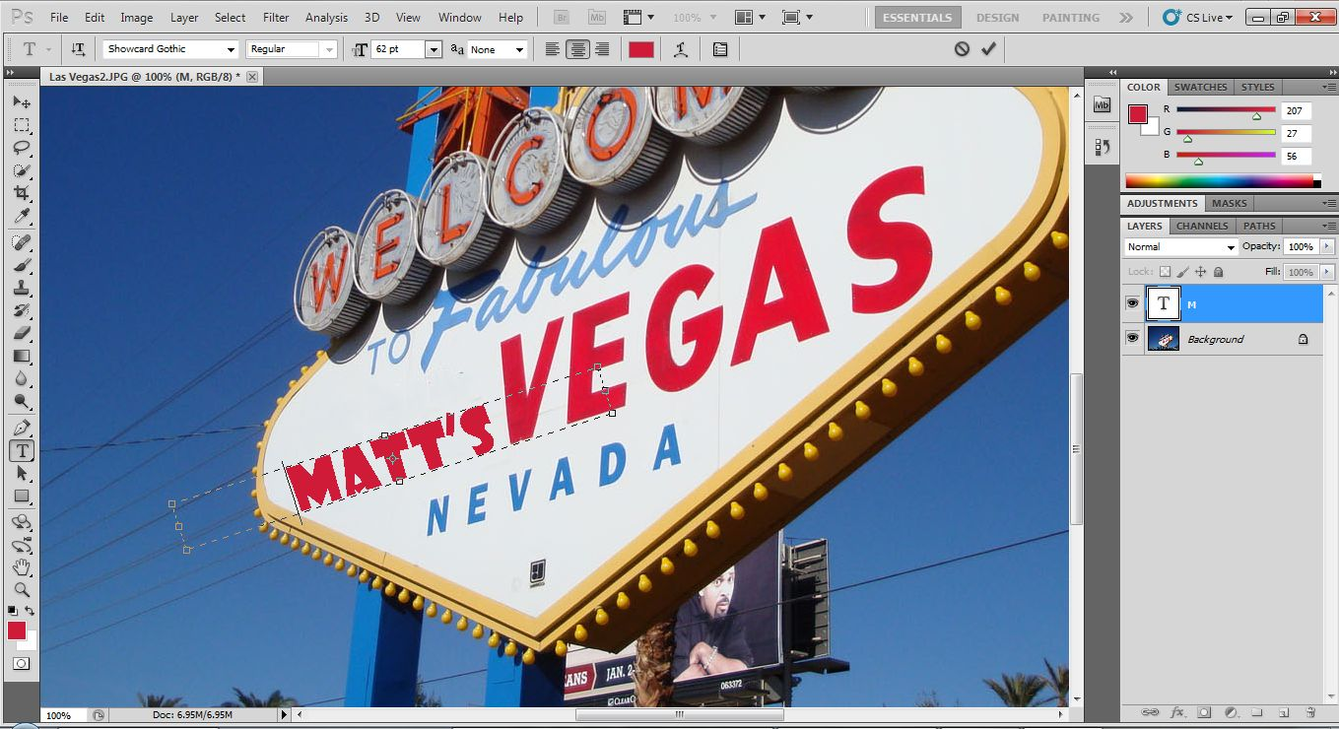
Attempt to bypass Planar Homography in Photoshop

Slide 22
Known Font
Assuming that the font style is known, the string in its world coordinate system can easily be determined. From the pair of images, we automatically extract the image and world coordinates required for the planar homography estimation

Slide 23
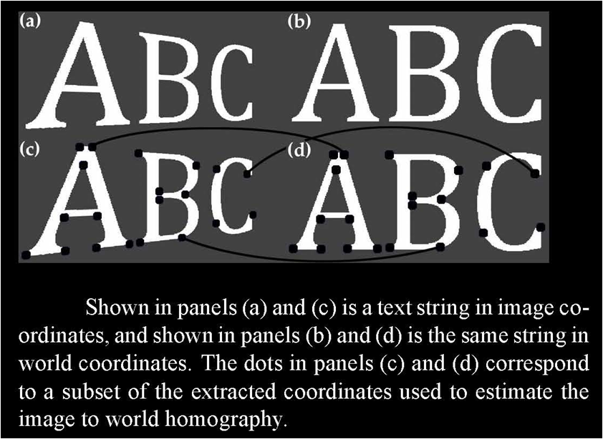
A feature vector consisting of local gradients is measured at each keypoint position. Keypoints are matched between two images using a variant of nearest neighbor matching on the feature vectors. This association accounts for a geometric transformation between the images by matching keypoints up to a planar homography.

Slide 24
Unknown Font
When the font of the text in question cannot be easily determined by visual inspection, we adopt the following technique for automatically identifying the font style.
The font style that returns the largest number of matched keypoints is taken to be the correct font.

Slide 25
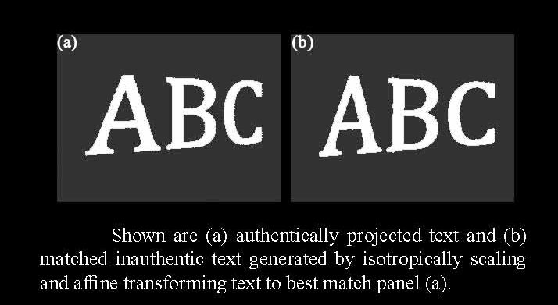
Photo Composite

Slide 26
Conclusions
Since no forgery is perfect, the inconsistencies in alignment and fonts often creep in.
With that said, it is quite easy to detect the forgeries in the signs using the mentioned techniques – for not all would know how to do a ‘Perfect murder’ of a billboard.
A determined forger could circumvent this technique by applying the correct homography to the inserted text. Taking this in account, relevant techniques like CFA interpolation, noise levels, can be considered.

Slide 27
ManipulationDetector® : Our MATLAB Application to detect text forgery
Term Project for CSI 660, Digital Image Forensics, Prof. Sewei Lyu
Important features:
Compact, just around 30 Lines of code.
Written completely in MATLAB
The system is able to detect inconsistencies in Planar Homography and Font.
We exclusively use Planar Homography techniques for this.

Slide 28
Demo Of Current Work

Slide 29
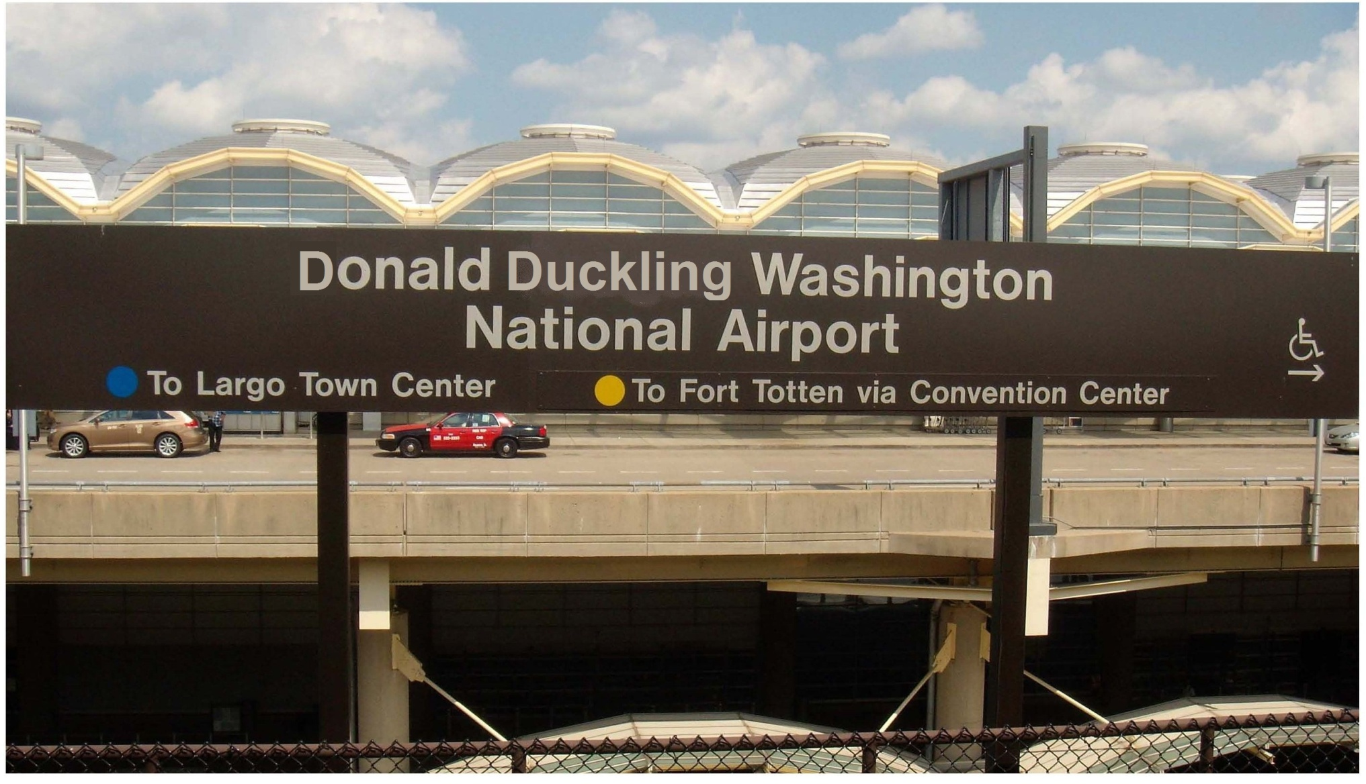
Planar Homography: Airport Sign

Slide 30

Homography: Airport Sign Original Picture

Slide 32


Slide 33
Our Technique For Known Font
Select two points on a letter in text area.
Repeat this procedure by selecting similar points for same letter which may be located in forged text area.
Program draws the lines. If the length of the lines is found to be same, the font is same.
The distances have to be in proportion if the plane is inclined

Slide 34
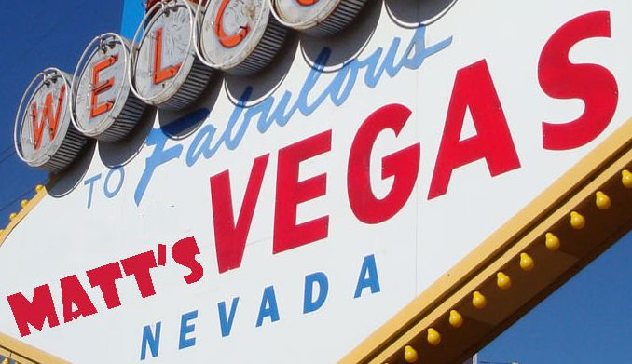
Incorrect Font in Fabulous Las Vegas

Slide 35
Comparison of ‘S’ (Proportional resize implemented here)
x
y
Since x ≠ y, fonts are inconsistent

Slide 36

Angled Surfaces : Proportions of Font Lengths remain Constant
x
y
x₁
y₁
For Consistent Fonts,
x / y = x₁ / y₁

Slide 37
Steps Software Takes For Detection

Slide 38
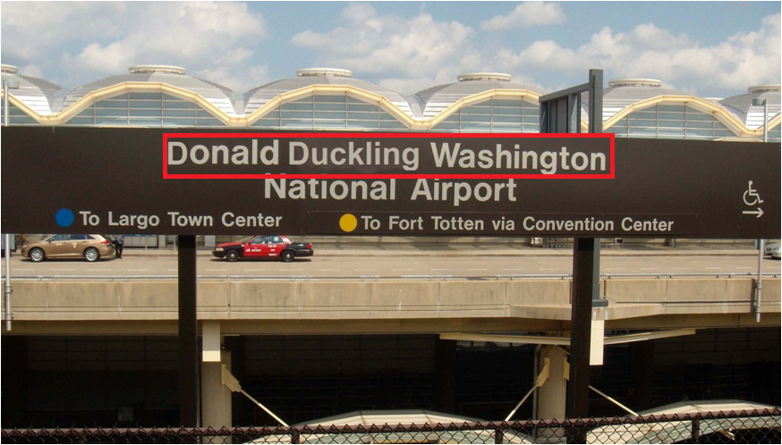
Text Area Selection

Slide 39
Selected text image saved as JPEG for MATLAB parsing

Slide 40
Points selected for linear comparison

Slide 41
Lines are drawn based on point profile The slopes of these lines can then be compared to determine the homography of the text

Slide 42
How does it work ?
Works by testing the principle of Planar Homography.
Tests if the text in the supposedly edited area is in same plane or not.
For considering this, we select points on the font.
Lines are drawn showing consistency of the plane in which the text is placed

Slide 43
Limitations
Works only if the edited text has been placed in inconsistent projection.
Cannot work if individual letters are placed in different planes .
Example: ‘Hollywood’ Meets ‘Bollywood’

Slide 44

Complicated Scenario: Multiple Planes, Different ‘Depth’

Slide 45

?

Slide 46
Limitations (Continued)
Works only if the edited text has been placed in inconsistent projection.
Cannot work if individual letters are placed in different planes .
Example: ‘Hollywood’ Meets ‘Bollywood’
May not work precisely for fonts that are closely related (i.e. Calibri and Cambria)

Slide 47
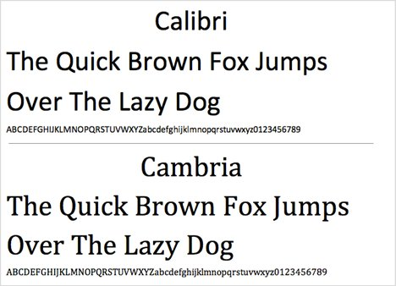
Calibri & Cambria

Slide 48
Limitations (Continued)
Works only if the edited text has been placed in inconsistent projection.
Cannot work if individual letters are placed in different planes .
Example: ‘Hollywood’ Meets ‘Bollywood’
May not work precisely for fonts that are closely related (i.e. Calibri and Cambria)
The results are largely altered if points are not correctly selected.

Slide 49
Future Work
Automate the selection process for Text Area.
Automated procedure for selecting the points for drawing lines for Planar Homography.
Complete detection mechanism for Font Inconsistencies by Font comparison automaton.
A detecting mechanism for CFA Interpolation & Noise Variations for better results.

Slide 50

Questions ??

